Slide 1

To Stay or not to stay in UK?
By Dev, Kirti & Sarita

Slide 2
Table of Content
Brief Intro
How they Expanded in the UK and European Market
What difficulties they faced
Their Main competitors
How their Competitors kept them at bay
What do you think they should have done (countermeasures in past)
Future prospects or goals

Slide 3
About Rakuten
Rakuten: started by Hiroshi Mikitani(founder & CEO) in 1997, one of the largest online platform, Japan-based internet services company.
Employes 14000+ over 72 countries in 2016
Global gross transaction 10 trillion yen and revenue 700 billion yen
1 billion members in the world and 90 mil members in japan
Business portfolio: e-commerce, credit cards, telecom, securities, banking, travel, etc.

Slide 4
About Rakuten
Rakuten has 2 business segments
Internet services
Financial technology
Rakuten has three revenue streams:
Hosting Fees
Transaction Fees
Advertising Fees

Slide 5
Rakuten Business Model: B-to-B-to-C
Merchant Business Plan
Consumer Demand
Shopping Experience
Product Promotion
Product Search
Purchase
Product Delivery
Notes:
In the early stages of its business model evolution, Rakuten focused on its core business of providing an electronic marketplace where consumers and merchants can interact and effect purchases
• It became clear that many other types of value added services were required or desirable to make the marketplace functional, highly integrated, and scalable, and so to create the competitive value proposition for which Rakuten is now so well known
• Initially these value adding complementary services were supplied by third party vendors, however Mikitani saw an opportunity to create a better customer experience and drive greater profitability by incorporating these services into the Rakuten business model – to supply more of the components of the full ecommerce Market Ecosystem

Slide 6
How Rakuten Expanded into UK Market & Europe
Rakuten Expanded into UK & Europe Market in 2005 with Acquisition campaign strategy.
Rakuten develop the whole management culture to be more inclusive and culturally diverse. Adapting the “global mindset”.
UK | Europe
Play.com | PriceMinister-France Tradoria-Germany & Austria Cabify & Glovo-Spain Dacadoo-Switzerland Simplesurance-Germany
Notes:
Work in progress * guys I deleted other partner in the UK to play.com only… From the essay Rakuten only acquire one company? (Play.com)

Slide 7
Difficulties in Europe
01
LANGUAGE
02
INTERNET ACCESS
Internet access spreadability is not equal in Europe. The region which has high internet access are only Northern & Western Europe
03
EUROPE UNIQUE MARKET
Customer prospects differed slightly to other European countries. (In Europe, the majority was France & Germany)
Each European country has its own domestic players, which is quite difficult to identified.

Slide 8
Difficulties in UK Market
01
CHOOSE THE WRONG PARTNER AT THE WRONG TIME
Play.com is already crashing down and rebranding itself to Rakuten. They have 14 million users. But are they active? The company is only sold dvd which the sales plummeted in 2011. Play.com itself not in a prime condition as customers may already switch to another streaming platform
02
A 5 YEARS TOO LATE TO ENTER THIS MARKET
Restructuring the whole Play.com business model from an ecommerce retailer to B2B2C requires a lot of time and they can’t compete with the agility of its competitor, Amazon
Notes:
Instead solving one major problems, they have two major problems: 1. Restructuring the whole business model (they had change Play.com from retailer to a platform-based service) 2. Marketing
Then, play.com start to rebrand themselves and there’s when Rakuten comes in. They adopt Rakuten business model. At that time, Amazon & Ebay already invade the UK market.
There’s no big-merchants on Rakuten that attracts customer like Amazon or Ebay.
Unattractive Promotional effort: collecting points - another big-player already do that. Argos, Wilko etc.
Play.com is not on their prime position, the brand itself is shrinking. They need investment for rebranding & restructuring. They probably think Rakuten will save them. But Rakuten itself is not familiar in the UK in this case.
Rakuten also late to enter this market

Slide 9
Rakuten Main Competitors: Amazon
Amazon History Timeline
Launch of Amazon.co.uk
Begins selling books
Opens Fulfilment Centre in Marston Gate, United Kingdom
Launches Amazon Associates Program
Launches Amazon Prime Video
M&S Outlet launches on Amazon Webstore
Sales of Kindle books overtake sales of print books on Amazon.co.uk
Amazon launches marketplace
1999 - 2001
2003 - 2009
Rakuten enters UK market
2016 - 2018
1998
2002
2010 - 2015
Opens Music Store
Opens DVD/Video Store
Opens Software & Video Games Store
Opens Electronics & Photo Store
Opens Toys & Games Store
Launches Free Shipping in the UK for orders over £39
Launches Amazon Web Services
Amazon launches shopping app for Apple users
Kindle with International Wireless available to UK customers
Third Annual Prime Day is Biggest Global Shopping Event in Amazon History
Launches the Amazon Prime Video App on Apple TV in Over 100 Countries
Launches Transparent Ad Marketplace in Europe
Notes:
In the UK & Europe (early 2016 up until now)
Amazon
Ebay
Amazon has been in the UK since 1998, start by selling books:
https://amazonuk.gcs-web.com/history-timeline
A marketplace is a platform where vendors can come together to sell their products or services to a curated customer base

Slide 10
How Amazon Keep Rakuten At Bay
-Strong online retail heavyweights like Amazon.com are taking notice of Rakuten and quickly designing specific counter strategies
-They provide services that make the customer switching - cost is high because they offer:
Efficient site- experience: All-in-one platform: you can find anything in the application & website (movie, streaming service,groceries, e-reader (kindle) and books: they also acquire book-selling e-commerce: bookdepository.com) which offer free delivery to all around the world.
Amazon provide shipping efficiency, flexibility and transparency.
Sometimes the product is cheaper on Amazon
Notes:
Amazon’s growing popularity is built more than ever on one chief advantage: shipping efficiency. Two of the top three reasons respondents cited for using Amazon are related to delivery: 73 percent said they choose the site for its fast, free shipping, while 67 percent are members of the company’s Prime shipping club, with guaranteed one- or two-day delivery on most items. An efficient site experience is also important, with 58 percent of respondents saying they choose Amazon for its easy and convenient purchase process.

Slide 11
How Rakuten should play it?
Delivery is important to the overall online shopping experience.
Provide free delivery service promotion, Weekend delivery, provide transparency as in let customers know the progress of the whole delivery
Spotlight authenticity and credibility
Problems with Rakuten ClubCards: Rakuten should be provided more clarity on how customers using their points. Rakuten partners doesn’t mention Rakuten on their websites (this raise question- are their partnership legit? )
Develop and promote a sustainability strategy.
Customers are likely more environmentally aware and tend to choose a online shopping platform with low carbon footprints. Offer recyclable packaging and/or “green” deliveries.
Notes:
Customer centric - more user-friendly
It has to adapt behaviour of the country (preferences, behaviour)
More promotional effort
In india: they provide free streaming service, they provide hallyu wave content (start offering products relating to that)
Free delivery service
https://www.theguardian.com/books/2020/nov/02/this-is-revolutionary-new-online-bookshop-unites-indies-to-rival-amazon
https://socialjusticebooks.org/about/why-boycott-amazon/

Slide 12
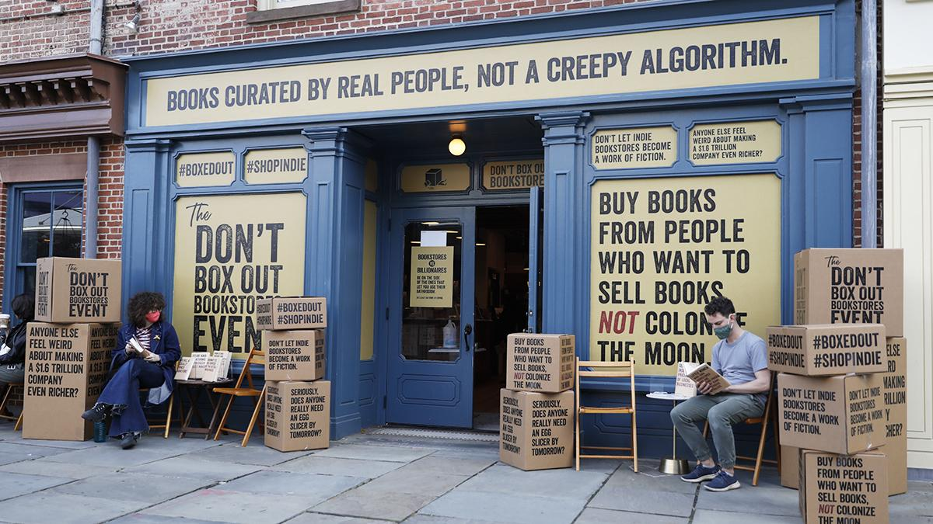
How Rakuten should play it?
4. Attract big merchants and small business owners / bookstores community in UK.
5. Adapt Good governance practice : Pay Taxes, Treat Labor as they should be treated
Amazon can offer “discounts” because they are cutting other costs: taxes, publisher payments, author payments, and safe-labor practices. This is why Amazon is notoriously known for adapting a capitalism model business and there are many merchants (mostly bookseller) that has been harmed by this practice. They are starting a boycott for Amazon.
An anti-amazon bookstore campaign
Notes:
https://www.independent.co.uk/arts-entertainment/books/indie-bookstores-launch-antiamazon-boxed-out-campaign-threats-dominance-bookstores-new-york-b1016641.html

Slide 13
References
https://internalconsulting.com/store/wp-content/uploads/2014/05/ICG-CCS-001-Rakuten.pdf
https://www.theguardian.com/books/2020/nov/02/this-is-revolutionary-new-online-bookshop-unites-indies-to-rival-amazon
https://amazonuk.gcs-web.com/history-timeline
Cleverism.com

